Slide 1
Parallel Adder
Parallel adder is binary digital circuit that produces the arithmetic sum of two numbers in parallel . It consists of full adders connected in a chain with the output carry from each full adder connected to the input carry of next full adder in the chain. In the below diagram, the are four full adders inter-connected to forming the parallel adder . In the parallel adder ,there are two inputs in which one is augend bits of A and other is addend bits of B. They are designated using subscripts from right to left where next full adder used the carry from previous adder in the chain.

Slide 2
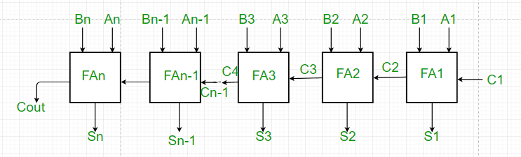
Figure of Parallel Adder

Slide 3
1. From the above figure, the first adder FA1 adds the input bits A1 and B1 to produce sum S1 and carry C2 which is connected to the next full adder in chain.
2. Similarly, next full adder uses the carry bit C2 from the previous adder to add with the input bits A2 and B2 to produce sum S2 and carry C3 which is further connected to the next full adder FA3 and so on.
3. This process is continued till last full adder FAn uses the carry bit Cn to add with inputs bit An and Bn to produce an output sum Sn with carry Cout.

Slide 4
Application of Register
A registers are the group of binary cells suitable for holding binary information. Registers can be form with the group of flip-flops . moreover , n- bit register has the group of n- bit group of flip-flops which is capable of storing binary information. Register is a sequential circuit which is widely used as storage device and memory to store many information in one instance or equipment

Slide 5
The main application of the register in field of information can be showen as following :
a) The main application of register is storing binary information or storing data in the digital form.
b) They also can hold data and address.
c) Registers are also used to make digital memory chips like ROM chips , Flash memory etc.
d) Cache memory in CPU is also made by registers.

Slide 6
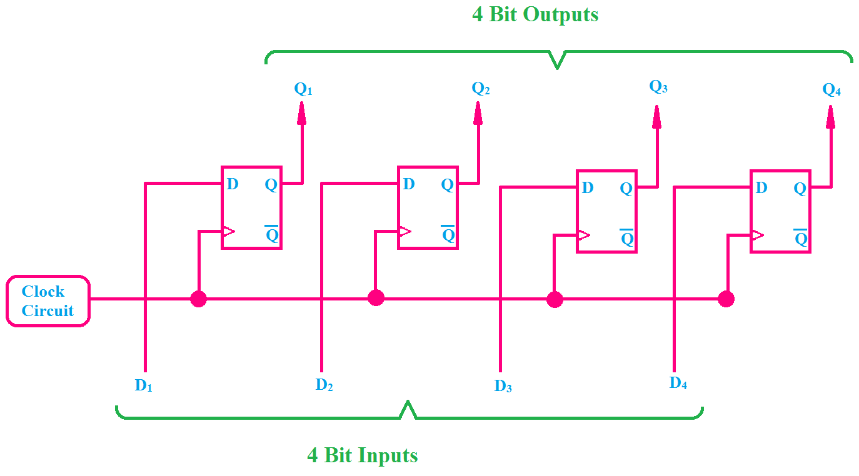
The following figure can be suitable to show the advancement and application of register :

Slide 7
In the above figure , we can see 4-bit registers with the combination of four flip-flips where each flip- flips is capable of storing one bit binary information so the total four flip-flops can store 4 – bit data and information . we can also see that clock terminal of every flip- flops are connected together due to there is single clock pulse for the all flip-flops . In case of any storage device which formed using flip-flops , the clock pulse is always given to the all flip- flops so we are using the the D- flip-flops in this figure.

Slide 8
Introduction Analog And Digital Devices
Analog devices:
Analog devices process analog signals (continuous time signals ) which can take any value within a range available on its scale .the examples of analog devices are output from the speaker or microphone.
Analog system process with continuous time signal .Analog system is varying wave sine form. In the analog systems ,the variables take on continuous value with continuous time.

Slide 9
Digital devices:
Digital devices process digital signals which can take only limited numbers of value (just two values are usually used : positive supply voltage and o volts).
Digital systems contain devices such as logic gates ,flip-flops , shift register and counters. In digital devices ,information variables represented by physical quantities.
Digital devices take the variables on discrete values. Moreover two level or binary values are most prevalent values in digital systems which have the bi-stable state of 0's and 1's. Digital system are less prone to error than analog system. Data representation in a digital system is suitable for error detection and correction.

